Slide 1
NE7202-NETWORK AND INFORMATION SECURITY
Unit I- Introduction

Slide 2
CONTENTS
Threats
Security Components
Security Attacks
Security Services
Security Mechanisms
Model for Network Security
IFETCE/M.E CSE/NE7202-NIS/Unit 1
Slide #1-<number>

Slide 3
Classes of Threats
Interception/Disclosure
  an unauthorized party (human or not) gains access to an asset
Interruption/Disruption
  an asset becomes lost, unavailable, or unusable
Modification/Deception
  an unauthorized party changes the state of an asset
Fabrication/Usurpation
  an unauthorized party counterfeits an asset
IFETCE/M.E CSE/NE7202-NIS/Unit 1
Slide #1-<number>

Slide 4
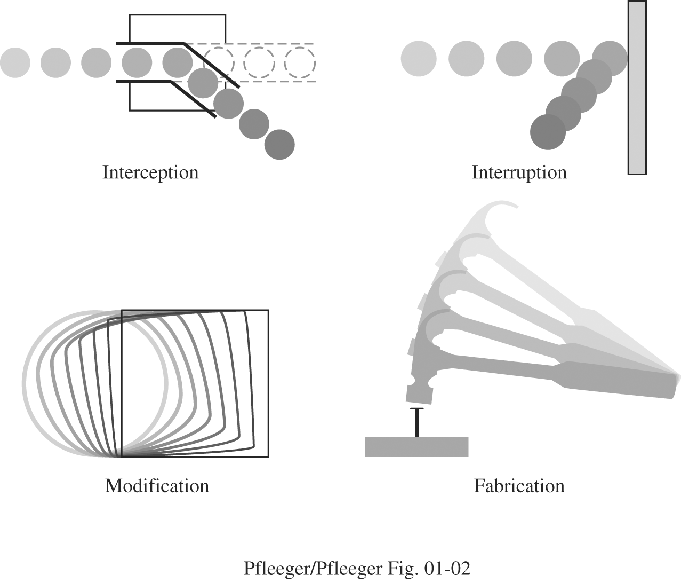
System Security Threats
IFETCE/M.E CSE/NE7202-NIS/Unit 1
Slide #1-<number>

Slide 5
Basic Security Components
Confidentiality : The assets are accessible only by authorized parties.
  Keeping data and resources hidden
Integrity: The assets are modified only by authorized parties, and only in authorized ways
  Data integrity (integrity)
  Origin integrity (authentication)
Availability: Assets are accessible to authorized parties.
  Enabling access to data and resources
IFETCE/M.E CSE/NE7202-NIS/Unit 1
Slide #1-<number>
Notes:
Confidentiality: a good example is cryptography, which traditionally is used to protect secret messages. But cryptography is traditionally used to protect data, not resources. Resources are protected by limiting information, for example by using firewalls or address translation mechanisms.
Integrity: a good example here is that of an interrupted database transaction, leaving the database in an inconsistent state (this foreshadows the Clark-Wilson model). Trustworthiness of both data and origin affects integrity, as noted in the book’s example. That integrity is tied to trustworthiness makes it much harder to quantify than confidentiality. Cryptography provides mechanisms for detecting violations of integrity, but not preventing them (e.g., a digital signature can be used to determine if data has changed).
Availability: this is usually defined in terms of “quality of service,” in which authorized users are expected to receive a specific level of service (stated in terms of a metric). Denial of service attacks are attempts to block availability.

Slide 6
Basic Components of Security
CIA
  Confidentiality: Who is authorized to use data?
  Integrity: Is data „good?”
  Availability: Can access data whenever need it?
C
I
S
A
S = Secure
CIA or CIAAAN… ☺
  (other security components added to CIA)
  Authentication
  Authorization
  Non-repudiation
  …
IFETCE/M.E CSE/NE7202-NIS/Unit 1
Slide #1-<number>

Slide 7
Need to Balance CIA
Example 1: C vs. I+A
  Disconnect computer from Internet to increase confidentiality
  Availability suffers, integrity suffers due to lost updates
Example 2: I vs. C+A
  Have extensive data checks by different people/systems to increase integrity
  Confidentiality suffers as more people see data, availability suffers due to locks on data under verification
IFETCE/M.E CSE/NE7202-NIS/Unit 1
Slide #1-<number>
Notes:
In addition to all the rules and regulations, policies and procedures and the related system specific documentation, there are some current computer security issues of which you as the Executive should be made aware.

Slide 8
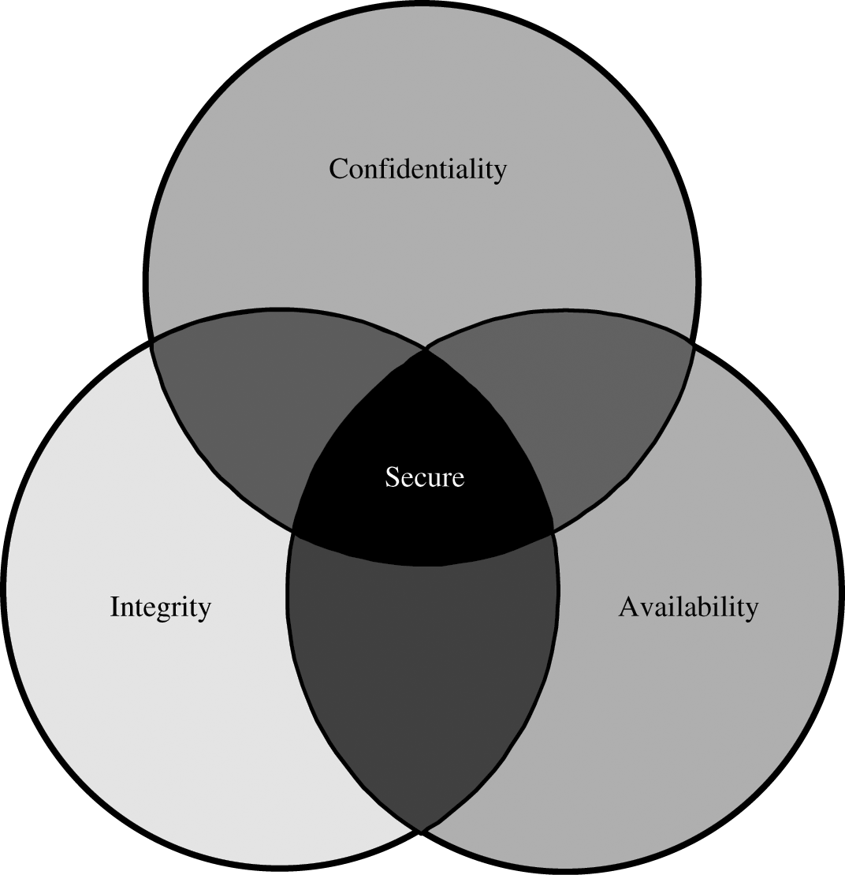
Relationship Between Confidentiality, Integrity, and Availability.
IFETCE/M.E CSE/NE7202-NIS/Unit 1
Slide #1-<number>

Slide 9
1. Confidentiality
“Need to know” basis for data access
  How do we know who needs what data?
  Approach: access control specifies who can access what
  How do we know a user is the person she claims to be?
    Need her identity and need to verify this identity
    Approach: identification and authentication
“Need to access/use” basis for physical assets
  E.g., access to a computer room, use of a desktop
IFETCE/M.E CSE/NE7202-NIS/Unit 1
Slide #1-<number>

Slide 10
2. Integrity
Integrity vs. Confidentiality
  Concerned with unauthorized modification of assets
  Confidentiality - concered with access to assets
  Integrity is more difficult to measure than confidentiality
    Could mean any subset of these asset properties:
  { precision / accuracy / currency / consistency /
  meaningfulness / usefulness / ...}
    Three aspects of integrity:
      Authorized actions
      Separation and protection of resources
      Error detection and correction
IFETCE/M.E CSE/NE7202-NIS/Unit 1
Slide #1-<number>

Slide 11
3. Availability
We can say that an asset (resource) is available if:
  Timely request response
  Fair allocation of resources (no starvation!)
  Fault tolerant (no total breakdown)
  Easy to use in the intended way
  Provides controlled concurrency (concurrency control, deadlock control, ...)
IFETCE/M.E CSE/NE7202-NIS/Unit 1
Slide #1-<number>

Slide 12
Attacks, Services, and Mechanisms
IFETCE/M.E CSE/NE7202-NIS/Unit 1
Slide #1-<number>

Slide 13
Definitions
Security Attack: Any action that compromises the security of information owned by an organization.
Security Mechanism: A mechanism that is designed to detect, prevent, or recover from a security attack.
Security Service: A service that enhances the security of data processing systems and information transfers of an organization. A security service makes use of one or more security mechanisms.

Slide 14
Security Attacks
An attack is any action that violates security.
  Active adversary
An attack has an implicit concept of “intent”
  Router mis-configuration or server crash can also cause loss of availability, but they are not attacks
IFETCE/M.E CSE/NE7202-NIS/Unit 1
Slide #1-<number>

Slide 15
Types of Attacks on
Data CIA
Disclosure
  Attack on data confidentiality
Unauthorized modification / deception
  E.g., providing wrong data (attack on data integrity)
Disruption
  DoS (attack on data availability)
Usurpation
  Unauthorized use of services (attack on data confidentiality, integrity or availability)
IFETCE/M.E CSE/NE7202-NIS/Unit 1
Slide #1-<number>

Slide 16
Ways of Attacking Data CIA
Examples of Attacks on Data Confidentiality
  Wiretapping / snooping
Examples of Attacks on Data Integrity
  Modification: salami attack -> little bits add up
    E.g/ „shave off” the fractions of cents after interest calculations
  Fabrication: replay data -> send the same thing again
    E.g., a computer criminal replays a salary deposit to his account
Examples of Attacks on Data Availability
  Delay vs DoS
Examples of Repudiation Attacks on Data:
  Data origin repudiation: „I never sent it”
    Repudiation = refusal to acknowledge or pay a debt or honor a contract
  Data receipt repudiation: „I never got it”
IFETCE/M.E CSE/NE7202-NIS/Unit 1
Slide #1-<number>

Slide 17



Friends and enemies: Alice, Bob, Trudy
Well-known in network security world
Bob, Alice (lovers!) want to communicate “securely”
Trudy (intruder) may intercept, delete, add messages
Alice
Bob
channel
data, control messages
secure
sender
secure
receiver
data
data
Trudy

Slide 18
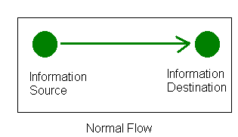
Security Attacks
Attacks on the security of a computer system or network are best characterized by viewing the function of the computer system as providing information.
In general there is a flow of information from a source, such as a file , to a destination, such as a hard disk.

Slide 19
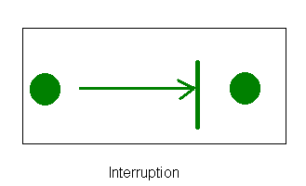
Security Attacks
Interruption: An asset of the system is destroyed or becomes unavailable or unusable. "This is an attack on availability.”
Example: the destruction of a piece of hardware, such as a hard disk, the cutting of a communication line, or the disabling of the file management system.

Slide 20
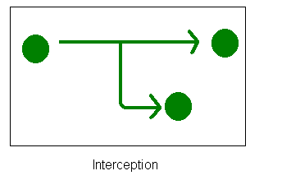
Security Attacks
Interception: An unauthorized user (party) gain access to an asset. “This is an attack on confidentiality.”
Examples: Wiretapping to capture data in a network, and the unauthorized copying of files or programs.

Slide 21
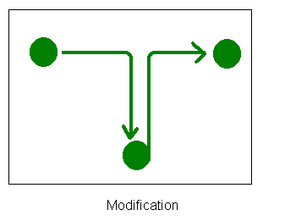
Security Attacks
Modification: An unauthorized user (party) not only gains access to but tampers with an asset. “This is an attack on integrity.”.
Examples: Changing data in a data file, altering a program so that it performs differently, and modifying the content of messages being transmitted on a network.

Slide 22
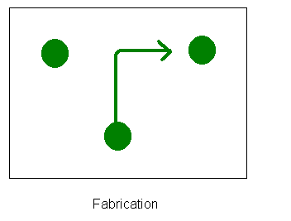
Security Attacks
Fabrication: An unauthorized user (party) inserts counterfeit objects into the system. “This an attack on authenticity.”.
Examples: Insertion of spurious messages in a network or the addition of records to a file.

Slide 23

OSI Security Architecture
ITU-T X.800 “Security Architecture for OSI”
Defines a systematic way of defining and providing security requirements
Slide #1-<number>
Notes:
To assess effectively the security needs of an organization and to evaluate and choose various security products and policies, the manager responsible for security needs some systematic way of defining the requirements for security and characterizing the approaches to satisfying those requirements. This is difficult enough in a centralized data processing environment; with the use of local and wide area networks,the problems are compounded. ITU-T Recommendation X.800, Security Architecture for OSI, defines such a systematic approach. The OSI security architecture is useful to managers as a way of organizing the task of providing security.

Slide 24
Aspects of Security
3 aspects of information security:
  Security attack
  Security mechanism
  Security service
terms
  threat – a potential for violation of security
  attack – an assault on system security, a deliberate attempt to evade security services
IFETCE/M.E CSE/NE7202-NIS/Unit 1
Slide #1-<number>
Notes:
The OSI security architecture focuses on security attacks,mechanisms,and services. These can be defined briefly as follows:
• Security attack: Any action that compromises the security of information owned by an organization.
• Security mechanism: A process (or a device incorporating such a process) that is designed to detect, prevent,or recover from a security attack.
• Security service: A processing or communication service that enhances the security of the data processing systems and the information transfers of an organization.The services are intended to counter security attacks, and they make use of one or more security mechanisms to provide the service.

Slide 25
Security Attack
Any action that compromises the security of information owned by an organization
Information security is about how to prevent attacks, or failing that, to detect attacks on information-based systems
Two generic types of attacks
  Passive
  Active
IFETCE/M.E CSE/NE7202-NIS/Unit 1
Slide #1-<number>
Notes:
Expand on definition and use of “security attack”, as detailed above.
See Stallings Table 1.1 for definitions of threat and attack.

Slide 26
Security Attacks
Passive attacks - eavesdropping on, or monitoring of, transmissions to:
  obtain message contents, or to monitor traffic flows
Active attacks – modification of data stream to:
  masquerade of one entity as some other
  replay previous messages
  modify messages in transit
  denial of service
IFETCE/M.E CSE/NE7202-NIS/Unit 1
Slide #1-<number>

Slide 27

Passive Attacks
IFETCE/M.E CSE/NE7202-NIS/Unit 1
Slide #1-<number>
Notes:
Have “passive attacks” which attempt to learn or make use of information from the system but does not affect system resources.
By eavesdropping on, or monitoring of, transmissions to:
+ obtain message contents (as shown above in Stallings Figure 1.3a), or
+ monitor traffic flows
Are difficult to detect because they do not involve any alteration of the data.

Slide 28

Active Attacks
IFETCE/M.E CSE/NE7202-NIS/Unit 1
Slide #1-<number>
Notes:
Also have “active attacks” which attempt to alter system resources or affect their operation.
By modification of data stream to:
+ masquerade of one entity as some other
+ replay previous messages (as shown above in Stallings Figure 1.4b)
+ modify messages in transit
+ denial of service
Active attacks present the opposite characteristics of passive attacks. Whereas passive attacks are difficult to detect, measures are available to prevent their success. On the other hand, it is quite difficult to prevent active attacks absolutely, because of the wide variety of potential physical,software,and network vulnerabilities. Instead, the goal is to detect active attacks and to recover from any disruption or delays caused by them.

Slide 29
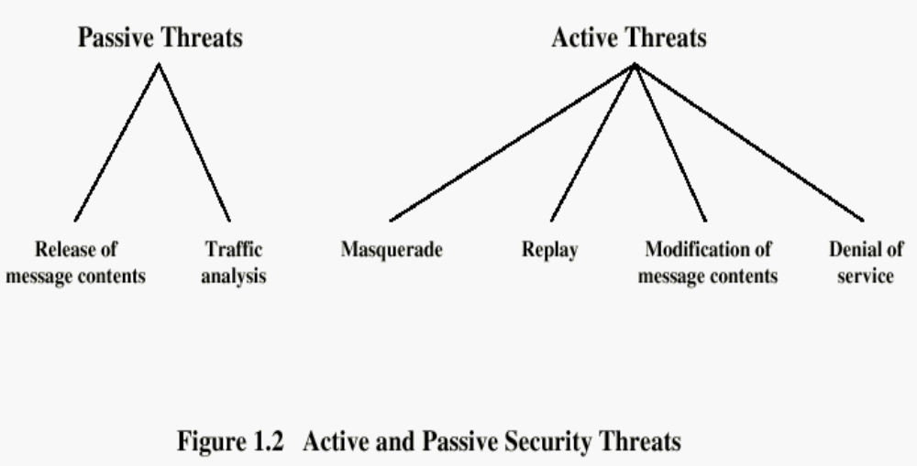

Security Attacks
IFETCE/M.E CSE/NE7202-NIS/Unit 1
Slide #1-<number>

Slide 30
Passive Attacks
Passive attacks do not affect system resources
  Eavesdropping, monitoring
Two types of passive attacks
  Release of message contents
  Traffic analysis
Example:
  Creating a customer profile of a user by using information about the sites that he or she visits.
Passive attacks are very difficult to detect
  Message transmission apparently normal
    No alteration of the data
  Emphasis on prevention rather than detection
    By means of encryption

Slide 31
Passive Attacks (1)
Release of Message Contents
Notes:
A useful means of classifying security attacks, used both in X.800 and RFC 2828, is in terms of passive attacks and active attacks. A passive attack attempts to learn or make use of information from the system but does not affect system resources.
Passive attacks are in the nature of eavesdropping on, or monitoring of, transmissions. The goal of the opponent is to obtain information that is being transmitted. Two types of passive attacks are:
+ release of message contents - as shown above in Stallings Figure 1.2a here
+ traffic analysis - monitor traffic flow to determine location and identity of communicating hosts and could observe the frequency and length of messages being exchanged
These attacks are difficult to detect because they do not involve any alteration of the data.

Slide 32
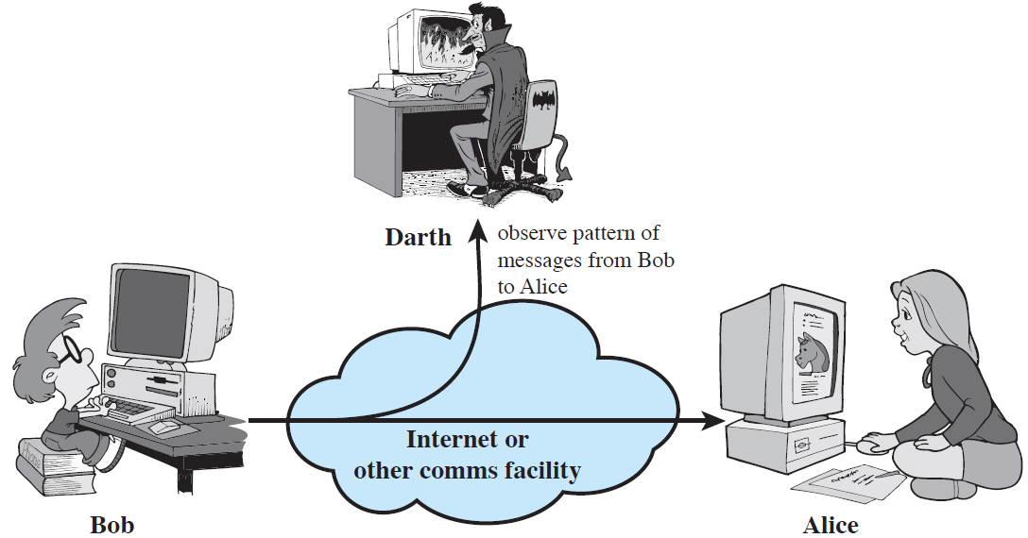
Passive Attacks (2)
Traffic Analysis

Slide 33
Active Attacks
Active attacks try to alter system resources or affect their operation
  Modification of data, or creation of false data
Categories: masquerade, replay, modification of messages, denial service.
Difficult to prevent
  The goal is to detect and recover
IFETCE/M.E CSE/NE7202-NIS/Unit 1
Slide #1-<number>

Slide 34
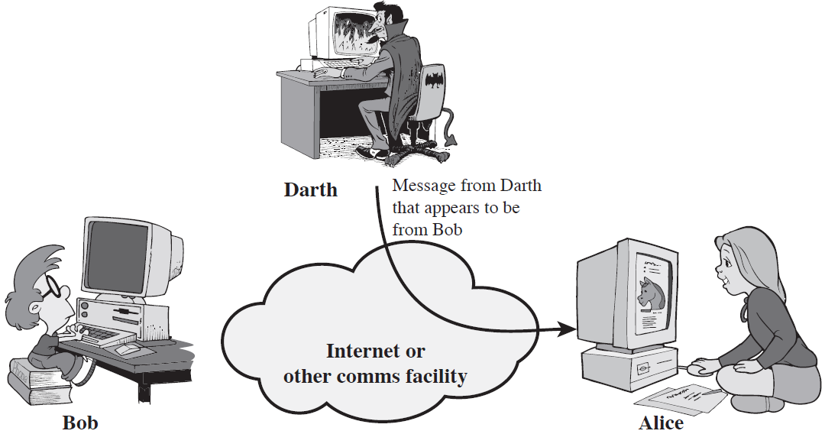
Active Attacks (1)
Masquerade
A masquerade takes place when one entity pretends to be a different entity.

Slide 35
Active Attacks (2)
Replay
Replay involves the passive capture of a data unit and its subsequent retransmission to produce an unauthorized effect.
Notes:
Active attacks involve some modification of the data stream or the creation of a false stream and can be subdivided into four categories: masquerade, replay, modification of messages, and denial of service:
masquerade of one entity as some other
replay previous messages (as shown above in Stallings Figure 1.3b)
modify/alter (part of) messages in transit to produce an unauthorized effect
denial of service - prevents or inhibits the normal use or management of communications facilities
Active attacks present the opposite characteristics of passive attacks. Whereas passive attacks are difficult to detect, measures are available to prevent their success. On the other hand, it is quite difficult to prevent active attacks absolutely, because of the wide variety of potential physical, software, and network vulnerabilities. Instead, the goal is to detect active attacks and to recover from any disruption or delays caused by them.

Slide 36
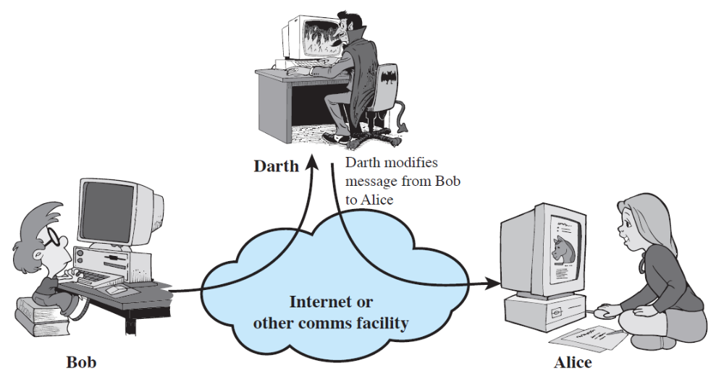
Active Attacks (3)
Modification of Messages
Some portion of a legitimate message is altered, or that messages are delayed or reordered, to produce an unauthorized effect.

Slide 37
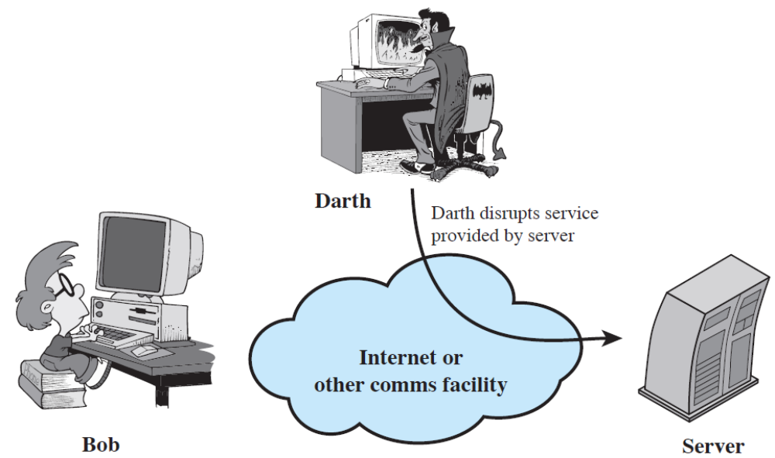
Active Attacks (4)
Denial of Service
Prevents or inhibits the normal use or management of communications facilities.

Slide 38
Example Security Violation 1
User A transmits a file to user B. The file contains sensitive information (e.g. payroll records) that is to be protected from disclosure. User C, who is not authorized to read the file, is able to monitor the transmission and captures a copy of the file during its transmission.

Slide 39
Example Security Violation 2
A network management application, D, transmits a message to a computer, E, under its management. The message instructs computer E to update an authorization file to include the identities of a number of new users who are to be given access to that computer. User F intercepts the message, alters its contents to add or delete entries, and then forwards the message to E, which accepts the message as coming from the manager D and updates its authorization file accordingly.

Slide 40
Example Security Violation 3
An employee is fired without warning. The personnel manager sends a message to a server system to invalidate the employee’s account. When the invalidation is accomplished, the server is to post a notice to the employee’s file as confirmation of the action. The employee is able to intercept the message and delay it long enough to make a final access to the server to retrieve sensitive information. The message is then forwarded, the action is taken, and the confirmation posted. The employee’s action may go unnoticed for some considerable time.

Slide 41
Example Security Violation 4
A message is sent from a customer to a stockbroker with instructions for various transactions. Subsequently, the investments lose value and the customer denies sending the message.

Slide 42
Security Service
Enhance security of data processing systems and information transfers of an organization
Intended to counter security attacks
Using one or more security mechanisms
Often replicates functions normally associated with physical documents
  which, for example, have signatures, dates; need protection from disclosure, tampering, or destruction; be notarized or witnessed; be recorded or licensed
Notes:
Consider the role of a security service, and what may be required.
Note both similarities and differences with traditional paper documents, which for example:
have signatures & dates;
need protection from disclosure, tampering, or destruction;
may be notarized or witnessed;
may be recorded or licensed

Slide 43
Security Services
X.800:
  “a service provided by a protocol layer of communicating open systems, which ensures adequate security of the systems or of data transfers”
RFC 2828:
  “a processing or communication service provided by a system to give a specific kind of protection to system resources”
IFETCE/M.E CSE/NE7202-NIS/Unit 1
Slide #1-<number>
Notes:
Also have a couple of definition of “security services” from relevant standards. X.800 defines a security service as a service provided by a protocol layer of communicating open systems, which ensures adequate security of the systems or of data transfers. Perhaps a clearer definition is found in RFC 2828, which provides the following definition: a processing or communication service that is provided by a system to give a specific kind of protection to system resources; security services implement security policies and are implemented by security mechanisms.

Slide 44
Security Services (X.800)
Authentication - assurance that communicating entity is the one claimed
  have both peer-entity & data origin authentication
Access Control - prevention of the unauthorized use of a resource
Data Confidentiality –protection of data from unauthorized disclosure
Data Integrity - assurance that data received is as sent by an authorized entity
Non-Repudiation - protection against denial by one of the parties in a communication
Availability – resource accessible/usable
Notes:
This list is taken from Stallings Table 1.2 which provides details of the 5 Security Service categories and the 14 specific services given in X.800.
This list includes the various "classic" security services which are traditionally discussed. Note there is a degree of ambiguity as to the meaning of these terms, and overlap in their use. The broad service categories are:
authentication is concerned with assuring that a communication is authentic. Two specific authentication services are defined in X.800: Peer entity authentication: provides corroboration of the identity of a peer entity in an association; and Data origin authentication: provides corroboration of the source of a data unit.
access control is the ability to limit and control the access to host systems and applications via communications links.
confidentiality is the protection of transmitted data from passive attacks, and the protection of traffic flow from analysis.
integrity assures that messages are received as sent, with no duplication, insertion, modification, reordering, replay, or loss.
availability is the property of a system / resource being accessible and usable upon demand by an authorized system entity, according to performance specifications for the system.

Slide 45
Security Services-Authentication
Concerned with assuring the identity of the sender (who created or sent the data)
Two specific authentication services are defined:
  Peer entity authentication
    Used in connection with a logical connection to provide confidence in the identity of the entities connected
  Data origin authentication
    In a connectionless transfer, provides assurance that the source of received data is as claimed
IFETCE/M.E CSE/NE7202-NIS/Unit 1
Slide #1-<number>

Slide 46
Security Services-
Access Control
Access control: is the ability to limit and control the access to host systems and applications via communications links.
  To achieve this control, each entity trying to gain access must first be identified, so that access rights can be tailored to the individual.
IFETCE/M.E CSE/NE7202-NIS/Unit 1
Slide #1-<number>

Slide 47
Security Services-
Data Confidentiality
Confidentiality is the protection of transmitted data from passive attacks
4 specific services:
  Connection confidentiality
  Connectionless confidentiality
  Selective-field confidentiality
  Traffic flow confidentiality
IFETCE/M.E CSE/NE7202-NIS/Unit 1
Slide #1-<number>

Slide 48
Security Services-
Data Integrity
Integrity service is the protection of data from unauthorized modifications during the transmission
Specific services:
  Connection integrity with recovery
  Connection integrity without recovery
  Selective-field connection integrity
  Connectionless integrity
  Selective-field connectionless integrity
IFETCE/M.E CSE/NE7202-NIS/Unit 1
Slide #1-<number>

Slide 49
Security Services-
Non-repudiation
This service prevents either sender or receiver from denying transmitted message.
Specific services:
  Nonrepudiation, origin
  Nonrepudiation, Destination
IFETCE/M.E CSE/NE7202-NIS/Unit 1
Slide #1-<number>

Slide 50
Availability Service
This service is concerned with assuring the permanence of a service or data for authorized users
Addresses the security concerns raised by:
- Denial of Service Attacks
- Virus that deletes files
Slide #1-<number>

Slide 51
Policies and Mechanisms
Policy: a statement of what is, and is not allowed.
  This defines “security” for the site/system/etc.
Mechanism: a procedure, tool, or method of enforcing a policy.
  Mechanisms enforce policies
Composition of policies
  If policies conflict, discrepancies may create security vulnerabilities
IFETCE/M.E CSE/NE7202-NIS/Unit 1
Slide #1-<number>
Notes:
Policy: may be expressed in
natural language, which is usually imprecise but easy to understand;
mathematics, which is usually precise but hard to understand;
policy languages, which look like some form of programming language and try to balance precision with ease of understanding
Mechanisms: may be
technical, in which controls in the computer enforce the policy; for example, the requirement that a user supply a password to authenticate herself before using the computer
procedural, in which controls outside the system enforce the policy; for example, firing someone for ringing in a disk containing a game program obtained from an untrusted source
The composition problem requires checking for inconsistencies among policies. If, for example, one policy allows students and faculty access to all data, and the other allows only faculty access to all the data, then they must be resolved (e.g., partition the data so that students and faculty can access some data, and only faculty access the other data).

Slide 52
Policies and Mechanisms (Cont)
Security mechanisms implement functions that help prevent, detect, and respond to recovery from security attacks.
Security functions are typically made available to users as a set of security services through APIs or integrated interfaces.
No single mechanism that will support all services required
Cryptography underlies many security mechanisms.
IFETCE/M.E CSE/NE7202-NIS/Unit 1
Slide #1-<number>

Slide 53
Types of Security Mechanisms
Prevention
  Prevent attackers from violating security policy
Detection
  Detect attackers’ violation of security policy
Recovery
  Stop attack, assess and repair damage
  Continue to function correctly even if attack succeeds
IFETCE/M.E CSE/NE7202-NIS/Unit 1
Slide #1-<number>
Notes:
Prevention is ideal, because then there are no successful attacks.
Detection occurs after someone violates the policy. The mechanism determines that a violation of the policy has occurred (or is underway), and reports it. The system (or system security officer) must then respond appropriately.
Recovery means that the system continues to function correctly, possibly after a period during which it fails to function correctly. If the system functions correctly always, but possibly with degraded services, it is said to be intrusion tolerant. This is very difficult to do correctly; usually, recovery means that the attack is stopped, the system fixed (which may involve shutting down the system for some time, or making it unavailable to all users except the system security officers), and then the system resumes correct operations.

Slide 54
Security Mechanisms (X.800)
Specific security mechanisms:
  Encipherment
  Digital signatures
  Access controls
  Data integrity
  Authentication exchange
  Traffic padding
  Routing control
  Notarization
Pervasive security mechanisms:
  Trusted functionality
  Security labels
  Event detection
  Security audit trails
  Security recovery
IFETCE/M.E CSE/NE7202-NIS/Unit 1
Slide #1-<number>
Notes:
see Table 1.5 for details of these mechanisms, and Table 1.6 for the relationship between services and mechanisms.
The “specific security mechanisms” are protocol layer specific, whilst the “pervasive security mechanisms” are not.
Will meet some of these mechanisms in much greater detail later.

Slide 55
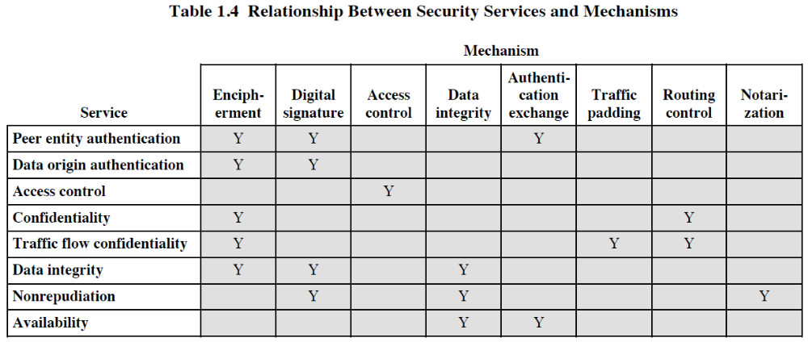

Slide 56

Model for Network Security
IFETCE/M.E CSE/NE7202-NIS/Unit 1
Slide #1-<number>
Notes:
In considering the place of encryption, its useful to use the following two models from Stallings section 1.6.
The first, illustrated in Figure 1.5, models information flowing over an insecure communications channel, in the presence of possible opponents. Hence an appropriate security transform (encryption algorithm) can be used, with suitable keys, possibly negotiated using the presence of a trusted third party.

Slide 57
Model for Network Security
Using this model requires us to:
  design a suitable algorithm for the security transformation
  generate the secret information (keys) used by the algorithm
  develop methods to distribute and share the secret information
  specify a protocol enabling the principals to use the transformation and secret information for a security service
IFETCE/M.E CSE/NE7202-NIS/Unit 1
Slide #1-<number>
Notes:
This general model shows that there are four basic tasks in designing a particular security service, as listed.

